Slide 1
Weekly Progress
Classification comparison between different columns groups and sorting methods
Compare supervise & unsupervised encoder together
Checking empty column while slicing continuous data to binary
A axis-rearrange method to level the categorical variable range
Considering PCA in selecting columns groups
Considering different data generation
New fitness function for GA encoder
Notes:
fitness

Slide 2
Random in [0,2^k]
Rnd. data
Binary data
Column Grouping
PC-n X, Y ,Z Rnd
slicing
Cont. data
Encoding each column group
Unsupervised | Column attribute | ➔ | Sorting rule | ➔ | Encoding methods
 | Column ID Sum (Avg) Rnd |  | Large to Small Small to Large Normal dist. |  | Categorical Grid
supervised | GA
Dim. reduced data
Rearrange
Classification
Notes:
X, Y, Z

Slide 3
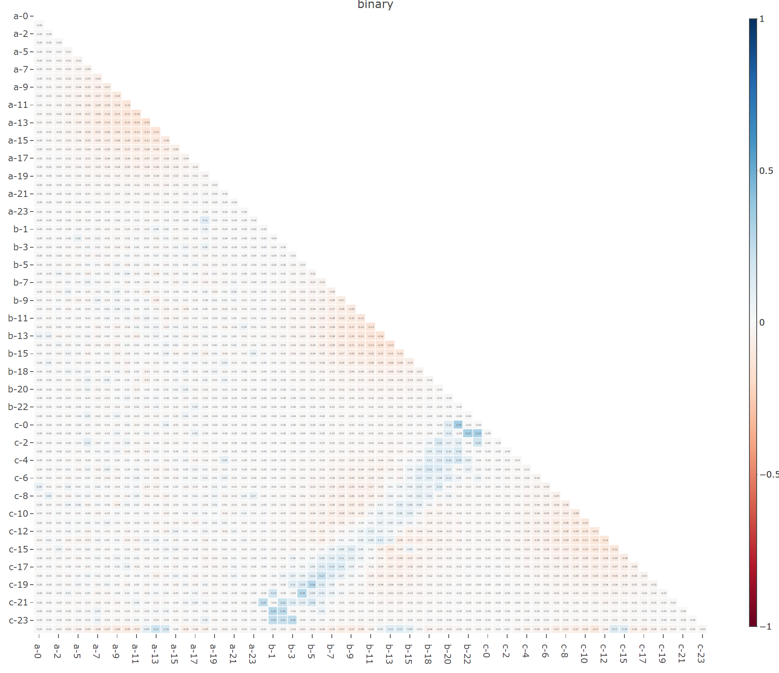
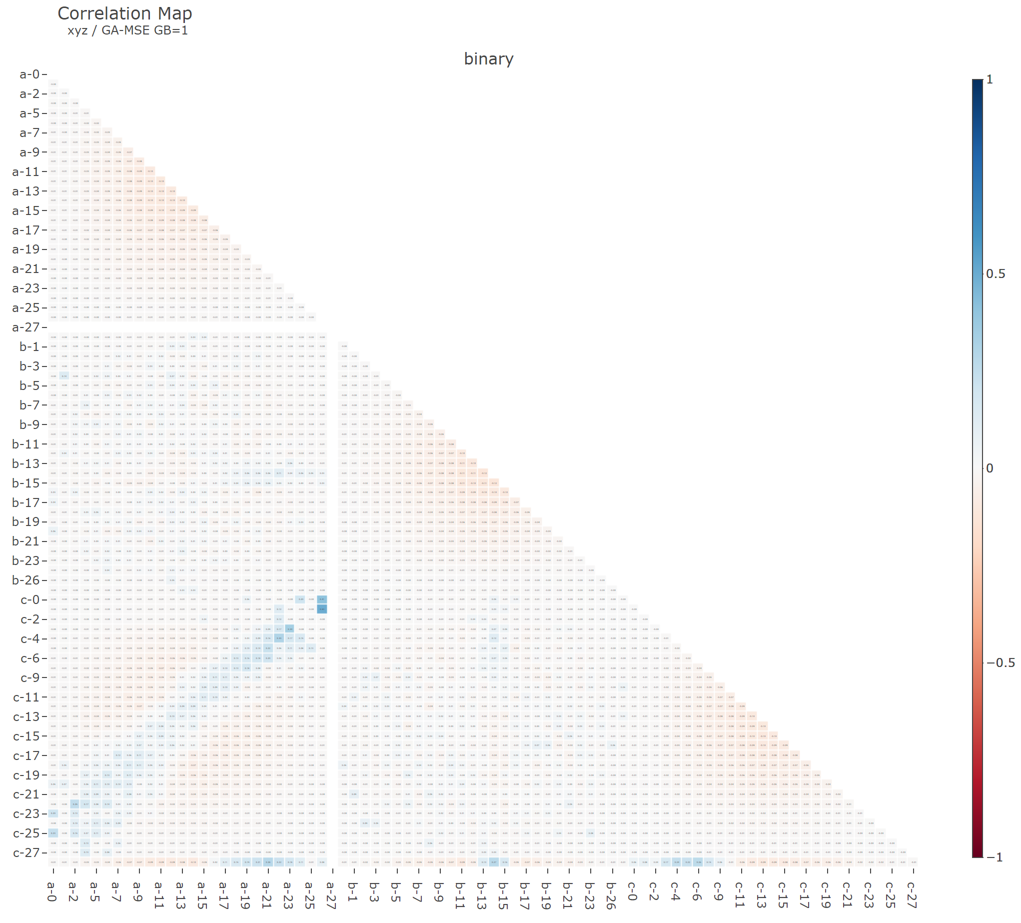
Slicing out empty binary column
Binary features: 69 | Binary features: 81

Slide 4
Binary Features | shape 1 | shape 2 | shape 3
50.
53.
56.
59.
62.
65.
68.
71.
74. |  |  | c-23
77.
80.
83. | b-26
86. | b-27 | a-27
89. | b-28 | a-28
92. | b-29 | a-29
95. |  | a-30
98. |  | a-31 | c-31
101. |  | a-31, a-32
104. |  | a-32, a-33
107. |  | a-33, a-34 | c-34
110. |  | a-34, a-35 | c-34, c-35
113. | b-36 | a-35, a-36 | c-35, c-36
116. | b-37 | a-36, a-37 | c-36, c-37
119. | b-38 | a-37, a-38 | c-37, c-38
122. | b-38, b-39 | a-38, a-39 | c-37, c-38, c-39
125. | a-40, b-39, b-40 | a-39, a-40, b-40 | c-38, c-39, c-40
128. | a-41, b-40, b-41 | a-40, a-41, b-41 | c-39, c-40, c-41
131. | a-41, a-42, b-41, b-42 | a-41, a-42, b-42 | c-41, c-42
134. | a-42, a-43, b-42, b-43 | a-42, a-43, b-43, c-43 | c-42, c-43
137. | a-43, a-44, b-43, b-44 | a-43, a-44, b-44, c-44 | c-43, c-44
140. | a-44, a-45, b-44, b-45 | a-43, a-44, a-45, b-45, c-45 | c-44, c-45
143. | a-45, a-46, b-45, b-46 | a-44, a-45, a-46, b-46 | c-42, c-43, c-44, c-45, c-46
146. | a-46, a-47, b-46, b-47 | a-45, a-46, a-47, b-47, c-47 | c-44, c-45, c-46, c-47
149. | a-47, a-48, b-47, b-48 | a-45, a-46, a-47, a-48, b-48, c-48 | c-45, c-46, c-47, c-48
Notes:
Drop zero column

Slide 5
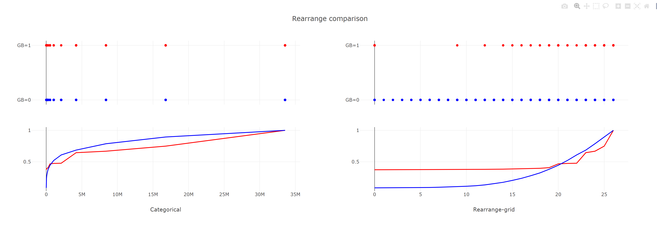
Rearrange encoded DataFrame
Rebuilt grid-like data
Level distance gaps cause by difference in columns sequencing

Slide 6
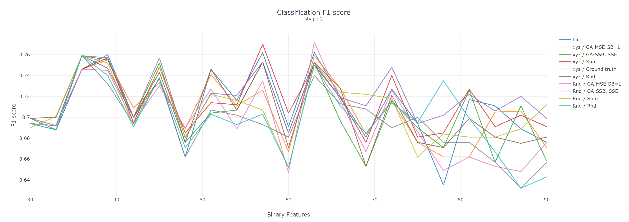
Classification results
Notes:
Pattern, 分類的結果, 誰沒有匡列

Slide 7
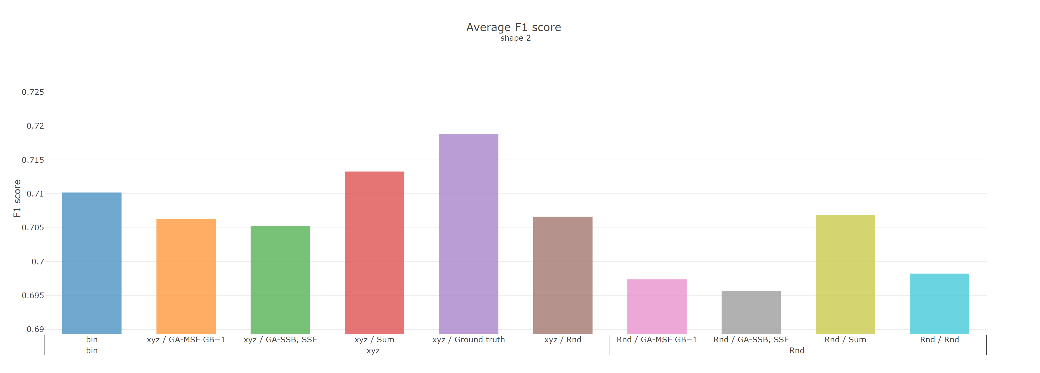
Classification average
Notes:
Check fitness
zero column ➔ Drop
Wave pattern, 分類的結果, 誰沒有匡列

Slide 8
Weekly Progress
Classification comparison between different shapes, and axis-rearrange methods
Drops out Empty columns if exist in binary data frame
Adding PCA columns grouping into comparison
Checks fitness calculation
Considering different data generations
New fitness functions
Notes:
Fitness
Overlap transform

Slide 9
Random in [0,2^k]
Rnd. data
Binary data
Column Grouping
PC-n X, Y ,Z Rnd
slicing
Cont. data
Encoding each column group
Unsupervised | Column attribute | ➔ | Sorting rule | ➔ | Encoding methods
 | Column ID Sum (Avg) Rnd |  | Large to Small Small to Large Normal dist. |  | Categorical Grid
supervised | GA
Dim. reduced data
Rearrange
Classification
Notes:
X, Y, Z

Slide 10
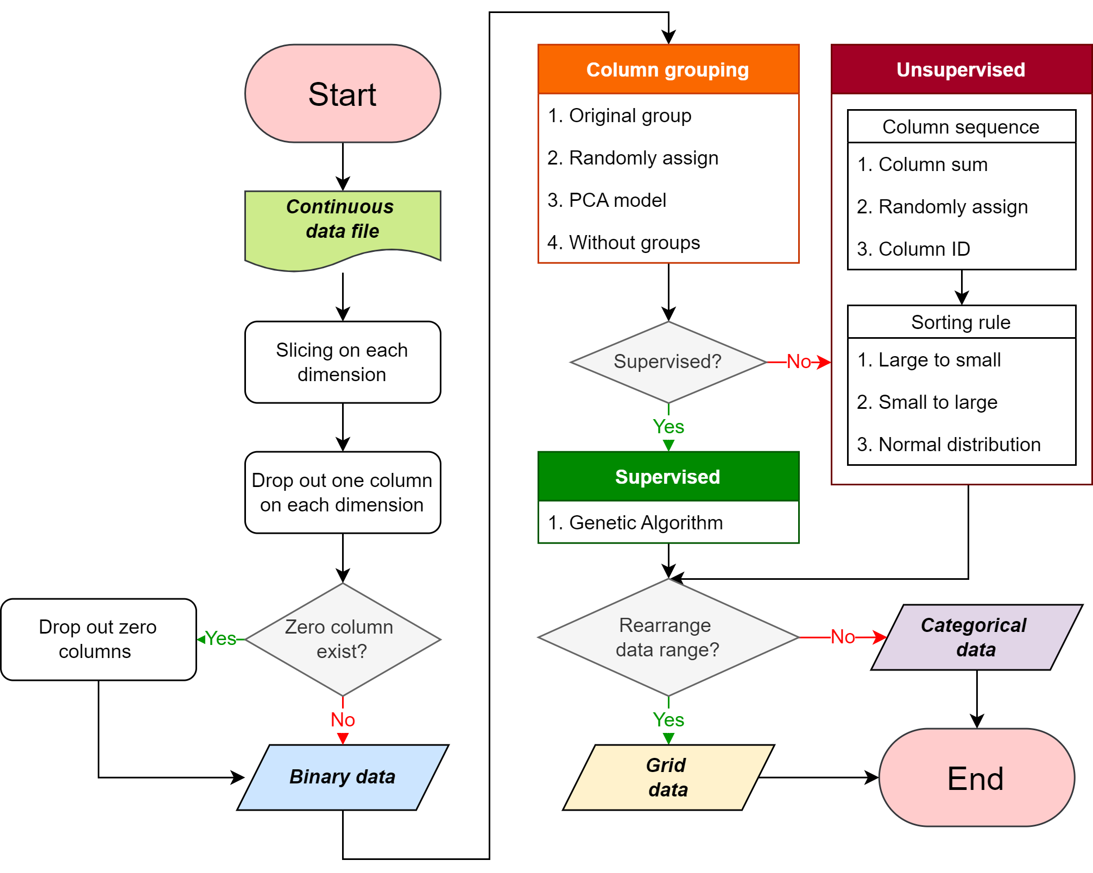

Slide 11
Structure flowchart
Dropout columns randomly until no Collinearity?
Dropout zero columns
Rearrange data range (categorical ➔ grid)
Notes:
Binary k-means
Inter-class correlation ICC
Binary correlation
Grouping methods

Slide 12
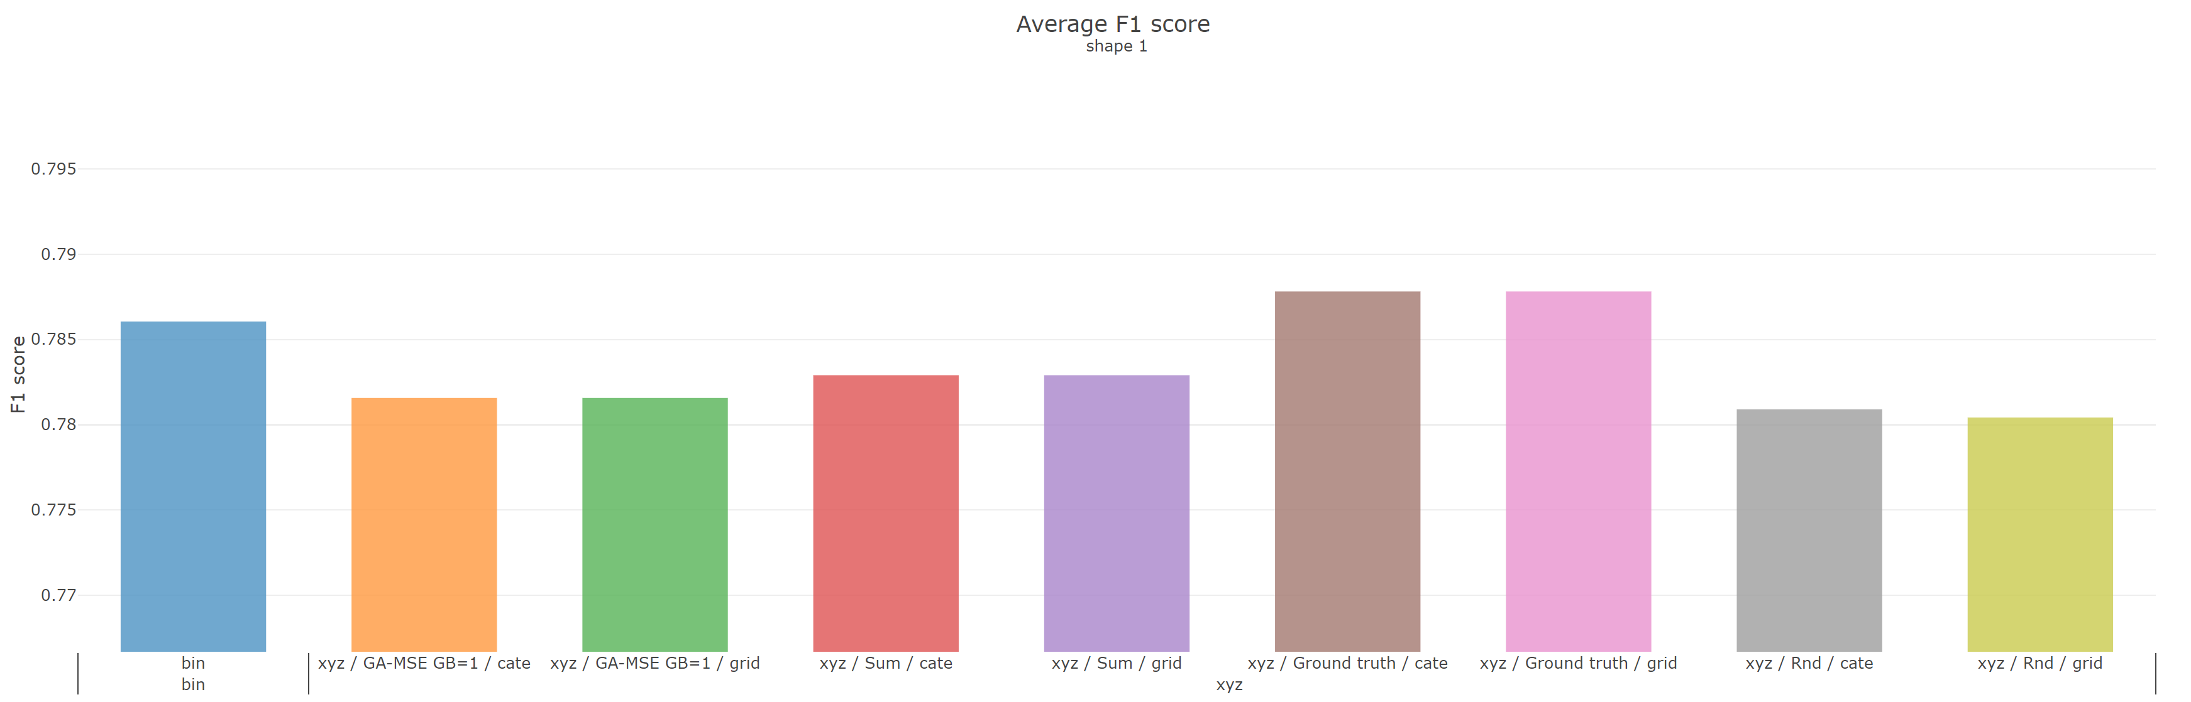
Rearrange axis range (gird vs. categorical)
Notes:
Recall, percision

Slide 13
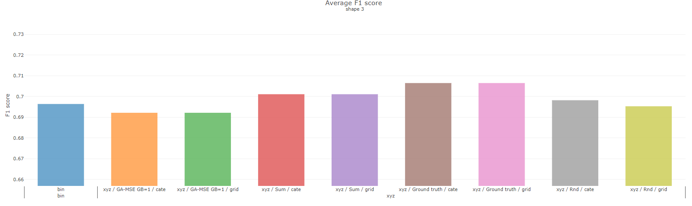

Slide 14
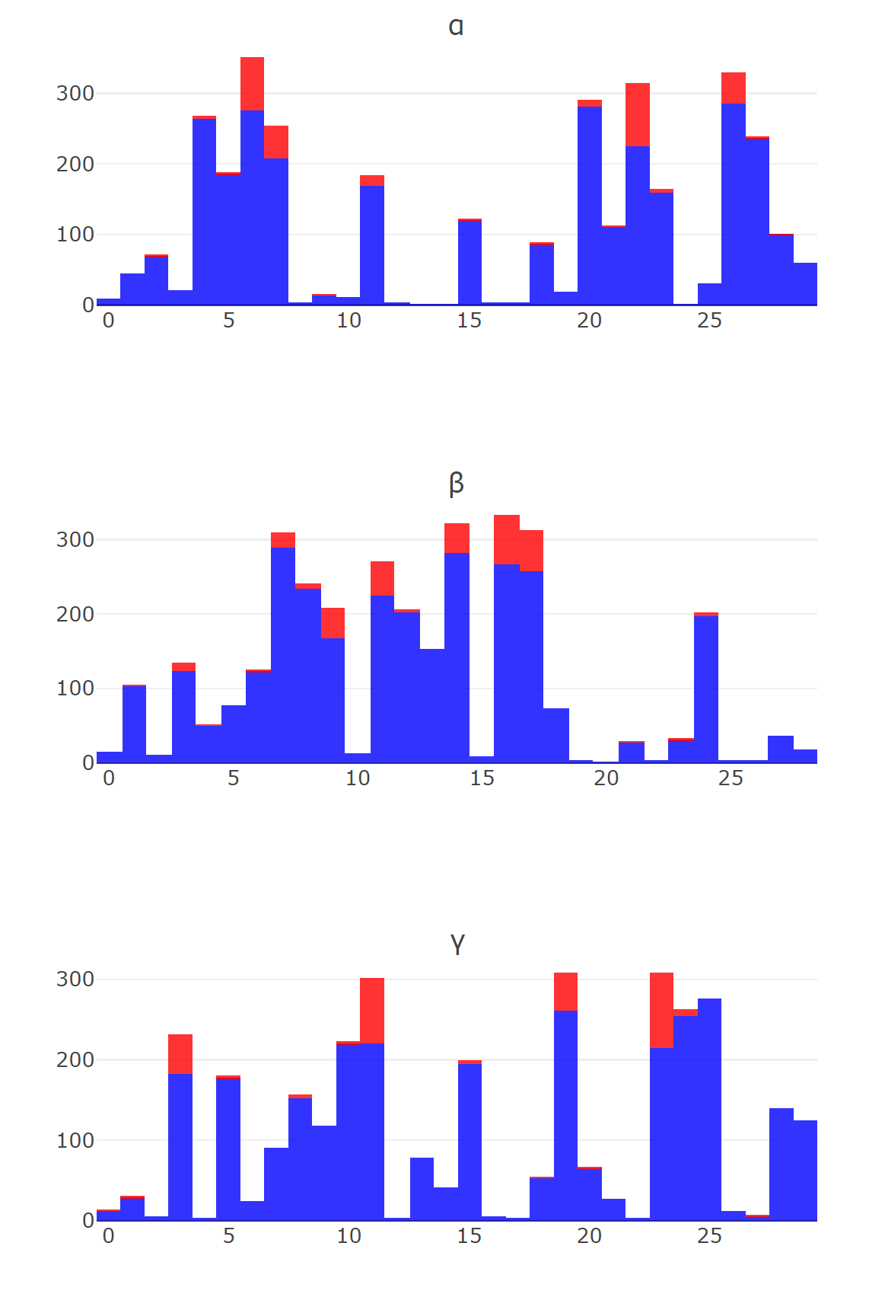
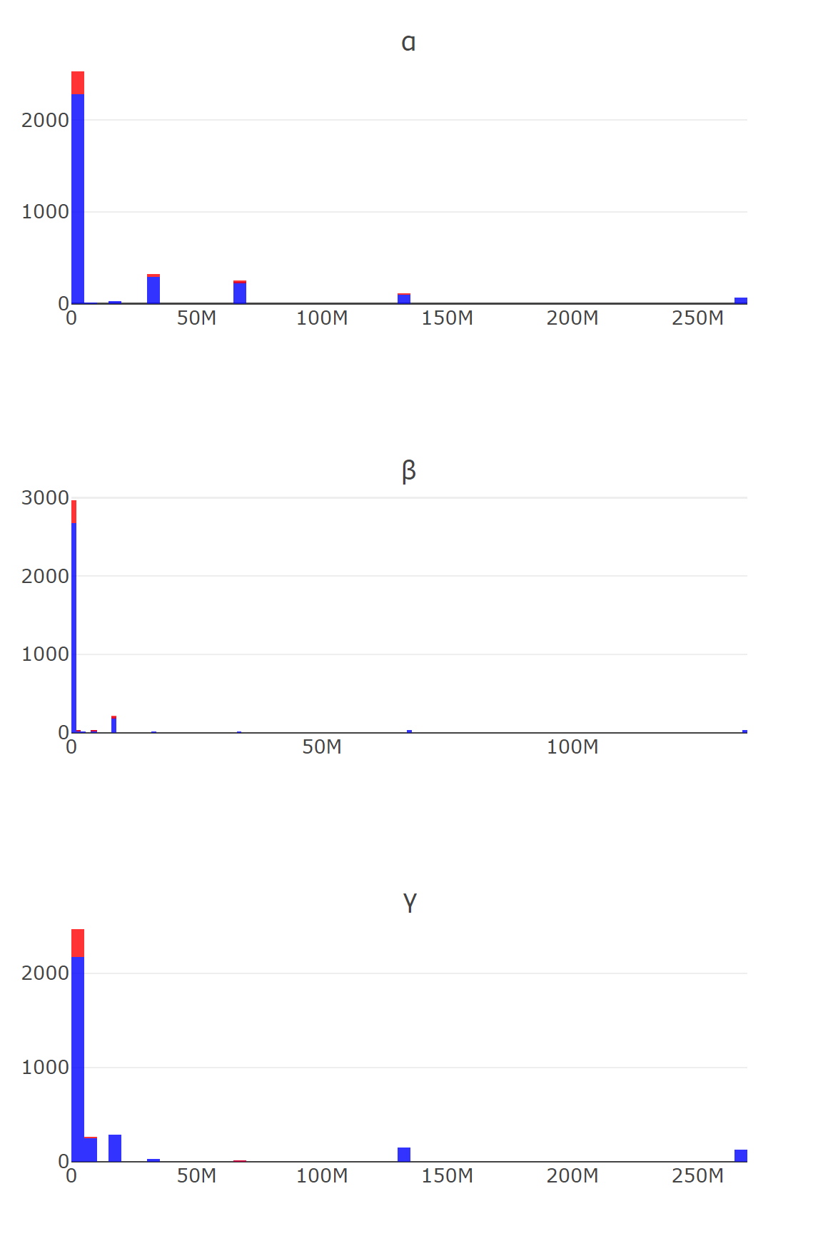
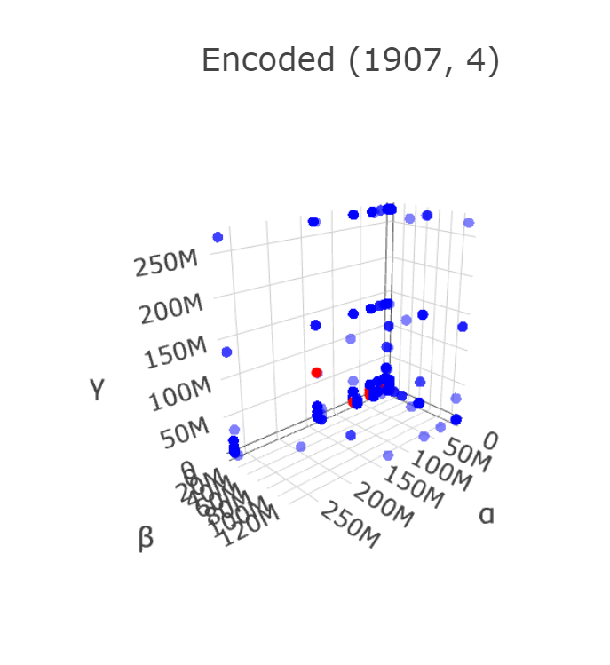
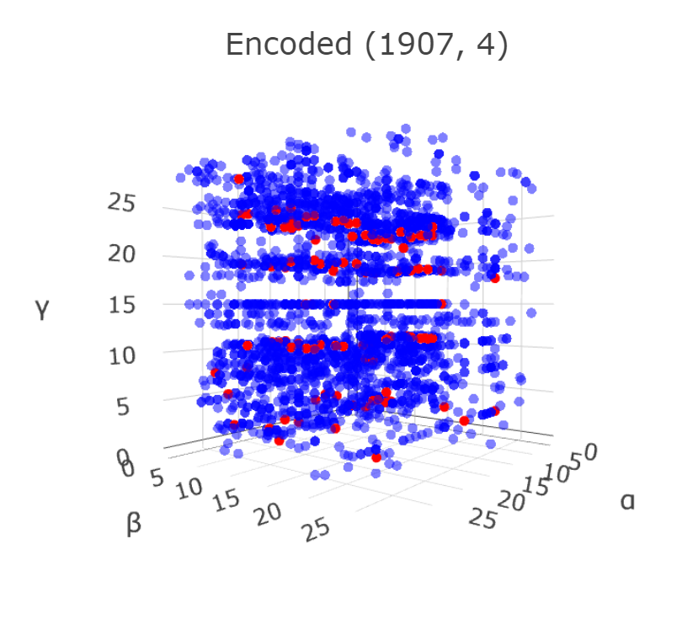

Slide 15
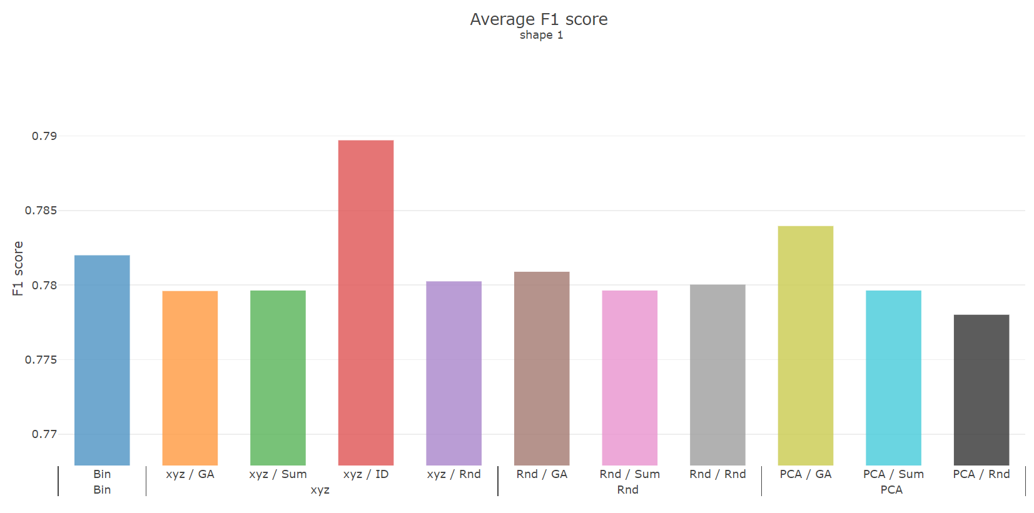
Classification comparison
Notes:
Pca abs

Slide 16
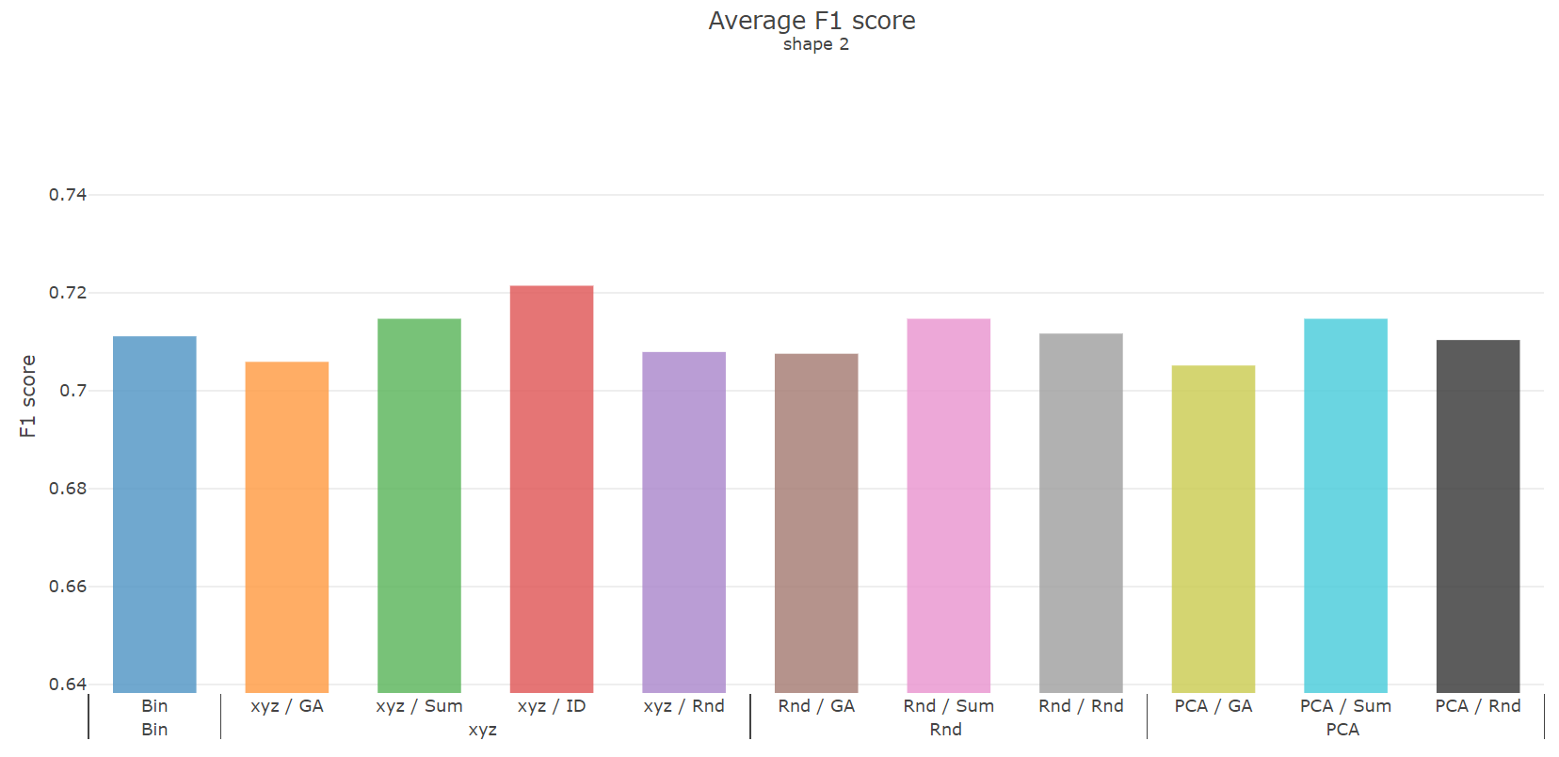

Slide 17
Grouping methods
Binary k-means
Inter-class correlation ICC
Binary correlation
Classification
Recall, precision
Overlap transform
PCA
Abs(weight)
GA
Fitness
Build GA model on each group

Slide 18
Weekly Progress - minor fix
PCA
by ABS(weights)
Classification
Record F1, Recall, and precision
Overlap transform
Grouping methods
Grouped Dataframe read-in
Notes:
Fitness
Overlap transform

Slide 19
Weekly Progress - new approaches
Classification comparison between different shapes, and axis-rearrange methods
Grouping methods
Grouping columns by binary correlation
Rearrange column value with type knowledge
Another supervise method

Slide 20
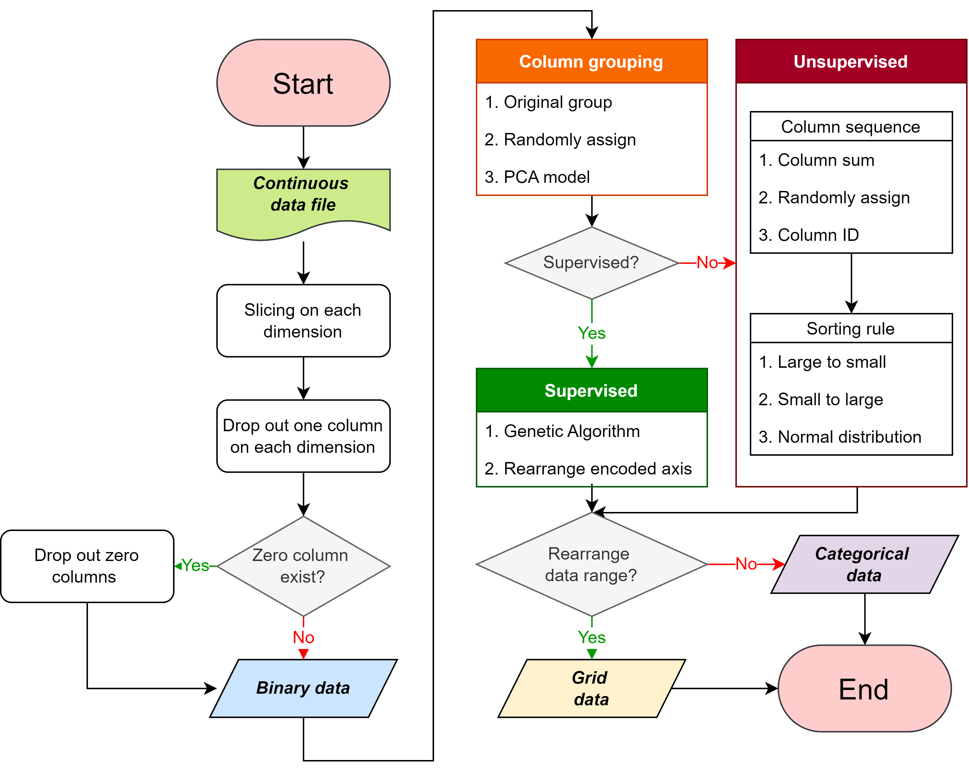

Slide 21
Random in [0,2^k]
Rnd. data
Binary data
Column Grouping
PC-n X, Y ,Z Rnd
slicing
Cont. data
Encoding each column group
Unsupervised | Column attribute | ➔ | Sorting rule | ➔ | Encoding methods
 | Column ID Sum (Avg) Rnd |  | Large to Small Small to Large Normal dist. |  | Categorical Grid
supervised | GA
Dim. reduced data
Rearrange
Classification
Notes:
X, Y, Z

Slide 23
Rearrange encoded column value
Sorting encoded categorical-column with data purity ratio

Slide 24
Group columns by correlations

